Slide 1
1
( Practical Molecular Biology
)
20 8 20 9
ؤ
1 - 1
ac R
Lac .Raghad Ibrahim
l .
Lab (9): Determination of the number of G + C%
ratio and melting point
The G, C, A, T ratios are constant in DNA, which is fixed in the living DNA. It can be
considered that the proportion of GC content or percentage of GC is almost constant from one DNA to another. This class is important in determining the genetic similarities between the two organisms. The estimation methods are PCR, DNA \ DNA, DNA \ RNA.
The molecule DNA can be considered as Thermo stable molecule un l the 70's. AND When the DNA liquid is heated up, the atoms that bind the two strand weaken and finally break the bond, when the two strips become separate by a process called
The temperature of which half of DNA are double strand and half-singl strand called
Melting temperature.
Tm is defining as( the degree at which 50% double stranded DNA and 50% of the them are single strand).
The Tm sample of DNA depends on several factors
•
•
Hydrogen bonds within the structure in the sample
The ratio of G=C ,because the tria bond between G = C pairs is more stable than the double index between the pairs A = T.
Not: The melting point of DNA sample increases the amount of information about
the sample composition (G \ C )contentز In double strand of DNA the nucleotide bases are complemented to each other by another word G = C, A = T So we follow the following law
AT%+GC%=100%
1=(T+C)\(A+G)
•DNA GC ratio by analysis of the melting point of DNAG-C% ratio by melting curve
analysis

Slide 2
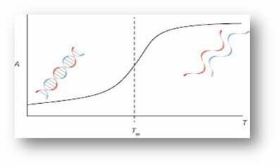
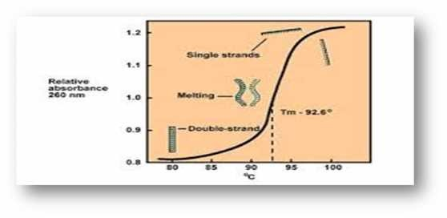
2
( Practical Molecular Biology
)
20 8 20 9
ؤ
1 -
1
ac R
Lac .Raghad Ibrahim
l
.
The Tm-value of DNA is easily determined by measuring absorbance at 260nm. The
distance base pairs leads to an increase in absorption. This is called hyper chromatic effect
The change in the secondary structure of DNA raises the result of that temperature,
which changes the absorption of light. For example, if the double-stranded DNA fluid had an absorp on rate of 1,00 = 260nm, the single-stranded DNA was absorbed at the same concentra on 260 = 1.37
This relationship is often described as a double-stranded DNA becoming
hyperchromic when heated. This difference is related to the spiral or helix of the DNA being stacked and when the separate DNA strips are gradually cooled back to their renaturated nature so the absorption of the eye will decrease because hyperchromic decreases.

Slide 3
3
( Practical Molecular Biology
)
20 8 20 9
ؤ
1 -
1
ac R
Lac .Raghad Ibrahim
l
.
The Tm- make the absorption values against the corresponding temperature.
The method of work-:
1.
Hang the DNA sample with TE buffer until we get a working concentration of
20 μg / mL.
balance spectrometer device at 260nm b TE buﬀer cable blank( Gradually preheat the DNA in the water bath and heat the absorbent at temperatures 50, 60, 70, 80, 90 and 100
Draw the DNA melting curve by placing the absorption values against the corresponding heat values. The curve of the curve is the melting point of its DNA sample.
Calculate the G-C substrates using the following equation
2.
3.
4.
5.
Tm=70+(0.47×G+C%)--------1
G-C% of DNA sample= (Tm- 70)× 2.5
هرارﺣ ﮫﺟردرﯾدﻘﺗﻟوtemp-: ﮫﯾﻟﺎﺗﻟا ﮫﻟدﺎﻌﻣﻟا لﻣﻌﺗﺳﻧ (
For temperature of renaturation. (TOR) estimation, we use the following equation:
TOR=52+(0.47×G+C%)--------2
Equa on 1 and 2 derive equa on 3
Tm=TOR+18----3

